Slide 1
OPSWAT Vietnam Center
Individual Innovation day
Metascan-online Process Monitor
Viet Nguyen
vtnguyen@opswat.com
Jul. 2014

Slide 2
Innovation Day
General
PROJECT PURPOSES:
List all running processes and their loaded modules on the machine
Leverage Metascan-online technology to to examine if each process and modules is compromised or not
FUNCTIONALITIES:
List and show all processes and modules in every 10 seconds.
Communicate with Metascan-online for scanning.
Show scanning results asynchronously.
FLATFORMS:
Windows and OSX

Slide 3
Innovation Day
Techniques
LANGUAGES:
Windows:
C/C++ for control processing
MFC for GUI
OSX:
C/C++ for control processing
Cocoa Objectvie-C for GUI
Other resources
Built-in libraries ( WinHttp for Win, CoreFoundation for OSX)
Self-built json for Wins and modified Yajl for OSX
Metascan-online api

Slide 4
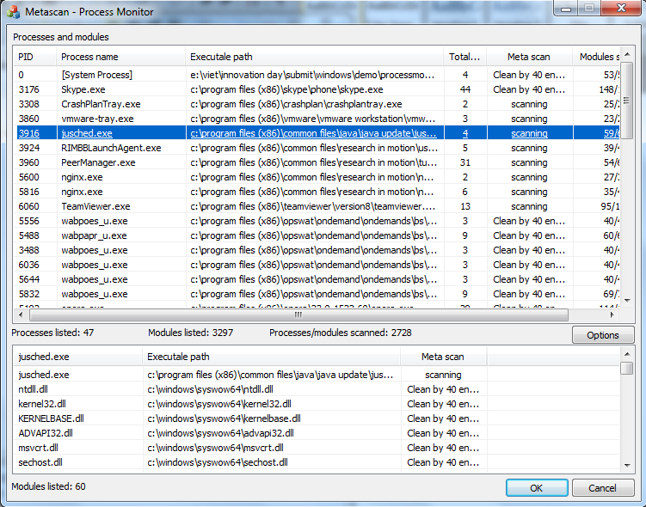
Innovation Day
Windows version

Slide 5
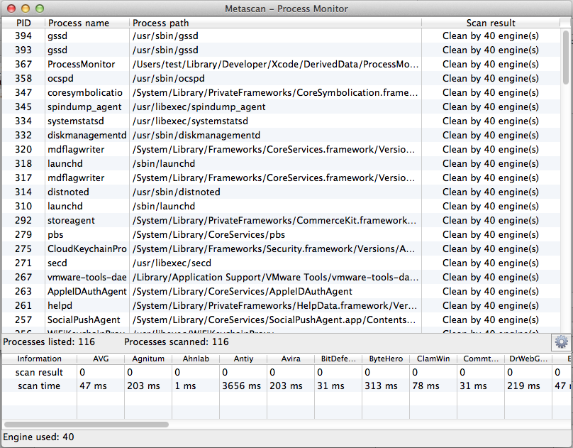
Innovation Day
OSX version

Slide 6
Innovation Day
Strong & weak points
STRONGS:
Native and low level facilities
Communicate to Metascan-online asynchronously
Update processes, modules & scanning results frequently
WEAKS:
Poor GUI

Slide 7
Innovation Day
THANKS FOR LISTENING

